Slide 1



Notes:
Welcome participants to the workshop
Presenter self-introduction
[Option to add a new slide with presenter’s information/bio]

Slide 2

SECTION 1
Overview

Slide 3
What is advance financial care planning?
If something unexpected happened to you, having a person you trust who can step in to help manage your bills, investments, income, property, and debts is important.
Advance financial care planning will help protect your money from fraud, exploitation, and costly financial mistakes.
This workshop will introduce you to the steps of advance financial care planning and get you started on making a personalized plan.
Notes:
Let’s begin with an overview. First, what is advance financial care planning?
[Talk through slides]
Remember, advance financial care planning is not about what happens to your money and property after you die. This is about getting help with financial decisions while you are alive but need some extra support.

Slide 4

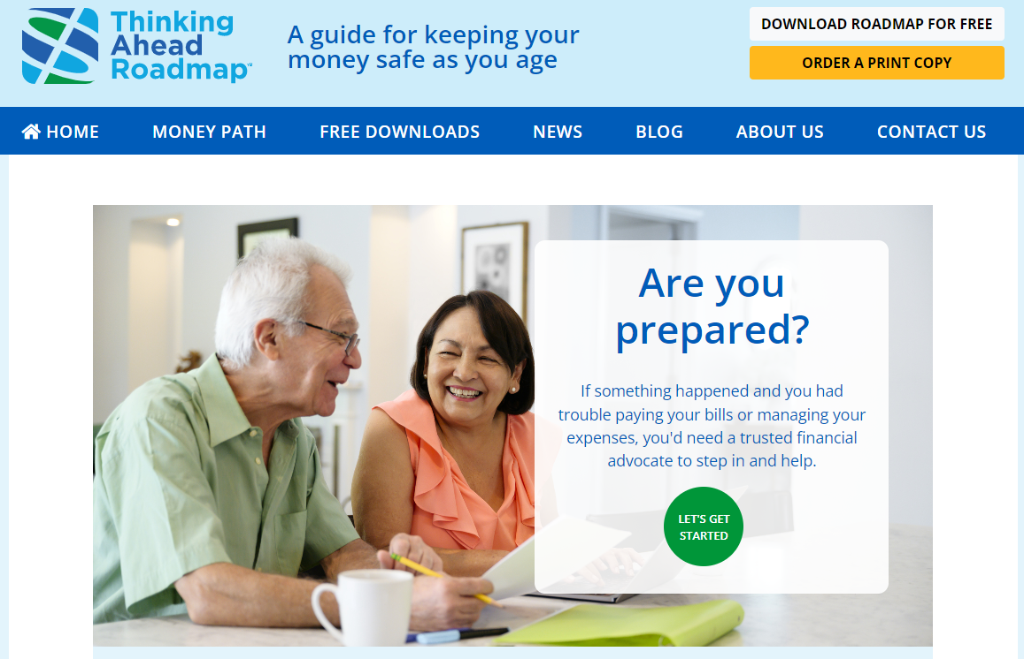
The Thinking Ahead Roadmap is here to help!
thinkingaheadroadmap.org
Notes:
This workshop is based on the Thinking Ahead Roadmap, a website and series of free print resources designed by researchers to help adults plan ahead.
The Roadmap walks you through the key stages of advance financial planning in six straight-forward steps.
We’ll hit some highlights today, but the Roadmap will give you more details on getting from A to Z. You can find it using the website listed on this slide.

Slide 5
Here is what we will cover in this workshop
Why advance financial care planning is important
How to pick someone you trust to be your financial advocate
How to organize your finances
Tips for beginning conversations about future money management
How to give your financial advocate the legal authority to help
Learning when to involve your financial advocate
Working closely with your advocate over time
Notes:
Let’s go over the agenda. In this mini workshop, we will….
[Read numbered agenda items]

Slide 6

Lois’s Story
When Lois’s spouse passed away, she was left to take over the household financial responsibilities. Unfortunately, her spouse never went over their bills with her. Lois forgot to pay off their credit card bill and neglected to pay her insurance premiums. The reminders had gone to her late husband’s email account. Months later, when her granddaughter came to help, she was surprised to find that Lois lacked coverage after a water leak that damaged the basement. Lois owed more than $1,000 in interest from an unpaid credit card balance.
Notes:
I’m going to share two real-life stories with you. First, let me share what happened to Lois.
[Read story on slide.]
Lois’s experience is not uncommon. Even in long-term relationships we sometimes fail to share important financial information with our partners. This can be a real problem when the household money manager passes away. The surviving spouse has to learn how to do these tasks without support, often while grieving their loss.

Slide 7

Cynthia’s Story
After Cynthia retired, her husband Max began to work more closely with her on managing their accounts, paying bills, and going over their insurance coverage. When Max had a stroke, Cynthia stepped in and made sure that all of his medical bills were paid and also fought unfair charges with Max’s healthcare provider and insurer. Because she was named as Max’s agent under power of attorney, she was able to use money in Max’s retirement account to help pay for his care.
Notes:
Let’s contrast Lois story with Cynthia’s experience.
[Read Cynthia’s story from the slide.]
Like Lois, Cynthia was left to manage the household finances on her own after Max had a stroke, but unlike Lois, she was prepared. Cynthia was Max’s agent under his power of attorney which allowed her to use funds in an account that was in Max’s name alone. It would have been much harder for Cynthia to pay Max’s medical bills and advocate for him if she were not named as Max’s agent and if she were unfamiliar with their household finances.

Slide 8

Activity: Pair & Share
Step 1: Select a conversation partner sitting near you.
Step 2: Take turns responding to the following prompt (3 min each):
Who in your life didn’t take the necessary steps to protect their money as they got older? What were the consequences? What could they have done early on to prevent these consequences?
Step 3: Volunteers share what they discussed with their partner with the broader group.
Notes:
I’m sure many of us have people like Lois and Cynthia in our lives. Let’s think of more examples of what can happen when we don’t engage in advance financial care planning using an activity called “pair and share”. This is how it works:
First, select a partner sitting near to you. (There can be groups of three people if needed.) Each person has two to three minutes to share with their partner, and then the next person has a chance to share. Here is what I would like you to talk about with your partner:
Think about someone in your life who didn’t take the necessary steps to protect their money as they got older. What were the consequences? What could they have done early on to prevent these things from happening?
After the 6 minutes are up, I will call us back as a group and will call on just of just a few people to share a story.

Slide 9
Why might people need help with financial decisions as they age?
Physical health issues such as a stroke, major surgery or illness that requires a long recovery and limits hearing, seeing, or getting around
Cognitive issues such as Alzheimer’s disease or any other type of dementia
Loss of a spouse who usually made financial decisions or paid the bills
Notes:
Some life and health events become more common as we age and can affect our decision making abilities. These events and experiences make it more important to have a plan.
[Read bullet points]

Slide 10



Did you know?
1 in 5 people age 75-79 have mild cognitive impairment or dementia.
Money management is typically the first cognitive ability affected by aging
Notes:
Needing help managing your finances is more common than you think. For example 1 in 5 people age 75-79 have dementia or mild cognitive impairment, which is an early form of memory loss or other decline in cognitive ability such as language and perception skills. That number goes up to 1 in 3 people after age 80.
Money management abilities are highly affected by aging processes in the brain. Issues may arise before other troubles such as short-term memory loss. Money management abilities may begin to decline many years before someone gets diagnosed with mild cognitive impairment or dementia.
Declines in financial abilities can even occur in people who never develop dementia.

Slide 11
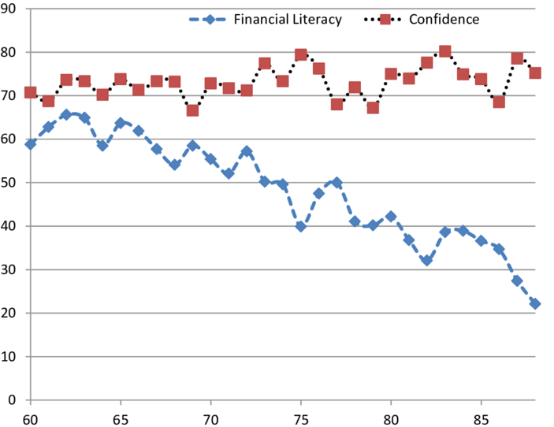
Despite lower financial literacy, confidence remains high
Confidence in one’s ability to properly manage money, credit, invest, and insure.
% correct
Percent of financial literacy questions answered correctly.
Age
Source: Finke, M. S., Howe, J. S., & Huston, S. J. (2017). Old age and the decline in financial literacy. Management Science, 63(1), 213-230.
Notes:
When people experience declines in their ability to manage money, they may not realize that they are having trouble.
The researchers in one study asked adults of different ages to take a financial literacy quiz, and also asked them how confident they were that their answers were correct. As you can see from this graph, there is a widening gap between their actual knowledge and what they thought they knew. Although adults in their late 70s and 80s were not performing well on the quiz, they were still highly confident that they got the right answer.
This study shows how important it is for everyone to have a financial back-up plan and to start their planning EARLY. Whether it be a stroke, a car accident, dementia, or even just normal aging, we need to have a person or people we trust to help with our financial decisions when we can’t make decisions on our own. This is especially true since we may be blind to our own financial skills and needs..

Slide 12


Advance financial care planning reduces risks
Reduces opportunities for fraud and exploitation
Reduces the chance of poor financial decisions
Eases the burden on future financial decision-makers by giving them instructions
Increases the chance that your financial needs and expectations are honored by those you trust
Notes:
Here are some of advantages of advance financial care planning.
[Go over each point.]

Slide 13






What does advance financial planning entail?
Select a trusted financial advocate
Start an open conversation
Make it official by getting a POA
Get finances in order
Share what matters most about your money needs
Plan to transition money management responsibilities
Notes:
So what does advance financial planning entail? The Thinking Ahead Roadmap researchers interviewed financial, legal, and healthcare professionals, and 150 older adults. Through the research they identified these six steps.
We’ll go over some of these steps today, but you can find more details on the Thinking Ahead Roadmap website. By the end of this mini workshop, you should have an idea of who you would trust to help you manage your money in the future and how to talk to them about your financial needs. You’ll also create a plan to complete your power of attorney documents so that your financial advocate is able to help when needed.

Slide 14

Words of wisdom
Planning is a PROCESS
Planning steps may happen out of order
Creating a solid plan does not require spending a lot of money on legal advice, but it will take time
Notes:
Before we get started on these steps, I want to remind you that advance financial care planning is not meant to happen in a single day. It’s a process that can take weeks or months.
Also, the steps do not have to happen in the order I shared. Some of you may have already completed some of the steps but need guidance on others, or maybe you are here just to make sure you are on the right track. That’s great too.
And the last point is that there is a legal step involved in developing a solid plan. This involves completing a power of attorney document, or for others, perhaps setting up a trust. This process doesn’t have to be expensive. But it will take time and effort. Luckily the effort will pay off!

Slide 15
Why do older people plan?
Notes:
The researchers who developed the Thinking Ahead Roadmap asked over 120 older adults why advance financial care planning was important to them.
You can see that more than 1/3 said that planning gave them peace of mind. Another quarter of participants said that they want to plan to avoid being a burden. Other reasons were to maintain financial autonomy and control, to have greater financial protection, and improve family harmony.

Slide 16
Activity: Group response
Why is advance financial care planning important to YOU?
What do you hope to gain by attending this workshop?
Notes:
Now I would like some of you to share.
Why are you here today? Why is advance financial planning important to you?
And, what do you hope to accomplish by the end of this workshop?
Who would like to share?
[Call on participants who raise their hands.]

Slide 17

SECTION 2
Picking your financial advocate
Notes:
In Section 2 of the Workshop, our objective is to talk about the roles and responsibilities of a financial advocate. We’ll also work together to identify what qualities and characteristics are important for financial advocates to have and what we should prioritize when picking our financial advocate.

Slide 18
What is a financial advocate?
?
A financial advocate is someone you would trust to assist you with money management tasks if you couldn’t handle these tasks on your own.
Notes:
A “financial advocate” is a person or people you would trust to help you with money management tasks if you couldn’t handle these tasks on your own.
We could also call this person a “financial caregiver.” Once you have legally named them as your financial advocate, you might call them your “agent under power of attorney”.
As an agent under power of attorney, your financial advocate has a legal duty to act in your best interest. They are not allowed to access and use your money or resources for themselves or in a way that doesn’t benefit you.
We’ll talk more about their duties later on in the workshop.

Slide 19
There are many tasks that your financial advocate may help you with:
Manage your day-to-day expenses
Pay your bills on time
Monitor your online accounts
Pay back money you owe
Oversee and help with investment decisions
Navigate insurance policies and filing claims
File and pay your taxes
Manage your property
Apply for public benefits
Donate to charitable causes that matter to you
Notes:
So what are the roles and responsibilities of a financial advocate?
There are many examples, such as paying bills, monitoring accounts, navigating insurance policies and filing claims, repaying loans, and even donating to charitable causes.
The tasks that a financial advocate may help you with will vary based on your money management needs. Many of us will only need help with more complex financial tasks as we age, such as preparing our taxes, making investment decisions, or applying for public benefits. Others may need more help with day-to-day tasks like paying bills and buying groceries and other personal items.
These tasks will also vary based on how complex your financial lives are. Some of us may have multiple investment accounts or properties that we’ll need help to manage, and others may have more simple finances.

Slide 20
Activity: Group response
?
It’s a big role, so you want to pick the right person…
What qualities should you look for in a financial advocate?
Notes:
Let’s do a group exercise. We all understand how important managing money is for our financial well-being. Many money management tasks are fairly complex and have a big impact on the future.
I’d like us to brainstorm as a group. What should your financial advocate be like? What characteristics and qualities are important for a financial advocate to have?
Feel free to just shout out your ideas. If you would be more comfortable, you can also raise your hand and I will make sure to call on you.
[Write participants’ ideas on a whiteboard or discussion board as they are shared. Click on the next slide to reveal the qualities that the authors of the Thinking Ahead Roadmap identified in their research.]

Slide 21

Activity: Group response
Look for these positive qualities
Trustworthy
Organized
Understands your needs and what is important to you
Reliable
Available to help
Smart decision-maker
Good communicator
Good listener
Puts your needs first
Financially savvy
Notes:
Here are what the researchers identified as important qualities for financial advocates. We identified many of these in our group brainstorm.
[Talk about 2-3 qualities from this list.]

Slide 22
Activity: Group response
?
It’s a big role, so you want to pick the right person…
What qualities should you avoid in a financial advocate?
Notes:
Now let’s brainstorm what qualities or characteristics we should avoid in a financial advocate. What qualities should warn us NOT to pick someone as our financial advocate?
[Write participants’ ideas on a whiteboard or discussion board as they are shared. Click to the next slide to reveal the qualities that the authors of the Thinking Ahead Roadmap identified in their research.]

Slide 23

Activity: Group response
Avoid these characteristics
Dishonest or secretive
Doesn’t pay bills on time
Faces personal legal or financial troubles
Has a serious mental health or addiction issue(s)
Likes to gamble
Owes money
Has a strong sense of entitlement
Doesn’t get along with the people who matter to you
Notes:
Here are what the researchers who developed the Thinking Ahead Roadmap identified as qualities to avoid. You shared many of these in our group brainstorm.
[Talk about 2-3 qualities from this list.]

Slide 24

Financial advocate myth busters
Myth: “I can only pick ONE financial advocate.”
Reality: Actually, having an alternate financial advocate is a smart idea. Your alternate advocate can take over if your primary advocate becomes unavailable. Just don’t pick everyone in your family to avoid hurt feelings. Then no one will know who you really want to be in charge.
Notes:
Here’s a common myth: “I don’t need a financial advocate because my spouse will manage our money if anything happens to me.”
[Click to reveal “Reality”.]
Actually, it’s fine to have more than one person. In fact, it’s smart to have a primary advocate and an alternate advocate who can step in if the first person becomes unavailable.
Now, we shouldn’t ask everyone in our family to be our financial advocate so that no one feels left out. That’s too confusing for everyone. But having a back-up person is helpful. They may be able help your primary advocate with some of the financial tasks and keep an eye on their behavior. If you do want them to work together, it’s best that the primary and alternate financial advocates get along. Also having a back-up person is really important in case your first choice isn’t able to help or passes away.

Slide 25
Financial advocate myth busters
Myth: “I don’t need a financial advocate because my spouse will manage our money if anything happens to me.”
Reality: Although your spouse may be the best choice now, you may outlive them or they may not be able to help with your finances because of a serious health issue. This is why it is so important to choose an alternate financial advocate in addition to your spouse or partner.
Notes:
Here’s another myth: “I don’t need a financial advocate because my spouse will manage our money if anything happens to me.”
[Click to reveal “Reality”.]
It’s fine to have your spouse be your primary financial advocate. Your partner should have your best interest at heart and know your money and household finances better than anyone else. However, you need to have another person as a back up, and so should they. Because the reality is that at some point, one of you will outlive the other, and the surviving spouse may need some help with money management in the future. We can’t always depend on our spouse being around as we age. We don’t know what’s in store.

Slide 26

Words of wisdom
It is okay if you don’t know anyone who has all of the positive qualities. The most important things are that they are trustworthy, available, and will put your needs above their own.
It’s best to have either your primary or alternate financial advocate be younger in age than you.
You don’t have to pick your oldest child or the family member who lives closest to you. Pick the person who is most qualified for the job.
Notes:
As a group, we identified some ideal qualities that we would want our financial advocate to have. It’s okay if the person you have in mind doesn’t have ALL of those qualities. Some are more important than others. Mainly, your financial advocate needs to be trustworthy, available, and will put your needs above their own.
Second, you’ll want a financial advocate who is younger than you. This younger person can be your back-up advocate. They can step in if your primary advocate, such as a spouse or sibling, passes away or is unable to help when you need them.

Slide 27

Activity: Worksheet
Who do you want to be your financial advocate?
Complete the first worksheet to help you think through who your first choice is for a financial advocate and who you would like as an alternate or back-up advocate.
Notes:
I’d now like you to do a solo activity that involves filling out this worksheet.
[Hold up, pass out, or display a copy of worksheet if virtual presentation.]
This is for you to keep. I won’t be collecting them.
We’ll take about 5 to 6 minutes on this activity.
[Give participants about 6 minutes to fill it out.]

Slide 28

Activity: Pair and share
Step 1: Select a conversation partner sitting near you.
Step 2: Take turns responding to the following prompt (3 min each):
Who are you considering asking to be your financial advocate? What makes you want to pick this person or people?
Step 3: Volunteers share what they discussed with their partner with the facilitator and broader group
Notes:
We are going to do another “pair and share” activity where we talk about our responses to the worksheet. Turn to your same partner and take turns sharing who you wish to have as your financial advocate and alternate financial advocate. What is it about these people that makes them right for the role?
Let’s have the person who shared second last time go first this time. I’ll call us back in 6 minutes or so to share as a group.

Slide 29
What if no one you know is right for this role?
If you have no options in your family or social circle, you may consider hiring someone. Here are some professionals that may provide money management services for a fee:
Daily Money Manager
Certified Public Accountant
Care Manager
Bookkeeper
Professional Fiduciary
Trust Officer
thinkingaheadroadmap.org/downloads
Notes:
Some of you may still be undecided about who you would want to have as your financial advocate. Maybe you are single and don’t have adult children, or maybe you do have kids but they are not great with money. If that’s you, I want to share that there are millions of older Americans facing those same concerns.
The researchers who developed the Thinking Ahead Roadmap interviewed some of these “solo” agers. Some of them selected a sibling and a personal attorney to be their primary and alternate financial advocates, others asked a niece or nephew, and then there were others who asked their pastors or other religious community leaders to be their advocate. Again, the most important qualities in a financial advocate are that they are trustworthy, available when you need them, and will put your needs and interests above their own. It’s absolutely fine if the people you know with those qualities are not your family members.
If you are still undecided or can’t think of anyone who is right for the role, there are also professionals who will manage your daily finances for a fee. Those professionals might have titles like trust officer, geriatric or life care manager, accountant, or daily money manager.
Make sure to look into their fee arrangements and what they can do for you. And as with friends and family, trustworthiness and honesty are just as important when hiring a professional.
To learn more about options for someone who is aging alone, turn to the handout “Advice for Solo Agers” that is available on the website at: thinkingaheadroadmap.org/downloads

Slide 30
SECTION 3
Create a Financial Inventory
Notes:
The next step is to tell your financial advocate what they need to know about your financial life. Creating an inventory of your money and legal and financial arrangements will help them to help and make sure that things don’t fall through the cracks.

Slide 31
Inventory should include all your financial information
Financial accounts Banks, insurance companies, credit unions, retirement plans, etc. Living expenses & regular bills Utilities, subscriptions, property taxes, insurance premiums, etc. Loans Mortgage, credit card, etc. | Household service providers House cleaning, gardening, etc. Professional advisors Doctors, accountant, financial advisor, insurance agent, lawyer, etc.
Notes:
Imagine you were in a serious car crash and you couldn’t talk with your financial advocate.
What information would your advocate need to know so that they can immediately help with your finances? You don’t want your advocate to be unaware of any bills that could come up while you are recovering.
This slide lists the possible aspects of your financial life that you’d want your advocate to know about.
It important to pull all of this information together and safely store it in one place. We’ll call this your financial inventory.

Slide 32
Inventory should include all your financial information
Sources of income Social Security, pensions, annuities, investment income, withdrawals from savings, etc. Real estate and personal property Home, investment property, cars, art, jewelry, etc. | 8. Utilities Electric, gas, phone, internet, trash, cable, etc. 9. Insurance payments Medicare, health insurance, life insurance, etc.
Notes:
You can see it’s not just your bank and credit card accounts that are important. It’s also information about your utilities, insurance, loans, and the contact information of any professionals you work with.

Slide 33
Your inventory should include…
Name of financial institutions/insurance companies
Location and contact information of agent/banker/advisor
Account number(s)
Account value(s), if applicable
Regular payments, if applicable
Usernames and passwords, if applicable
Date you last updated your inventory
Notes:
When you create your financial inventory, here is the information it needs to have.
[Read bullet points.]

Slide 34
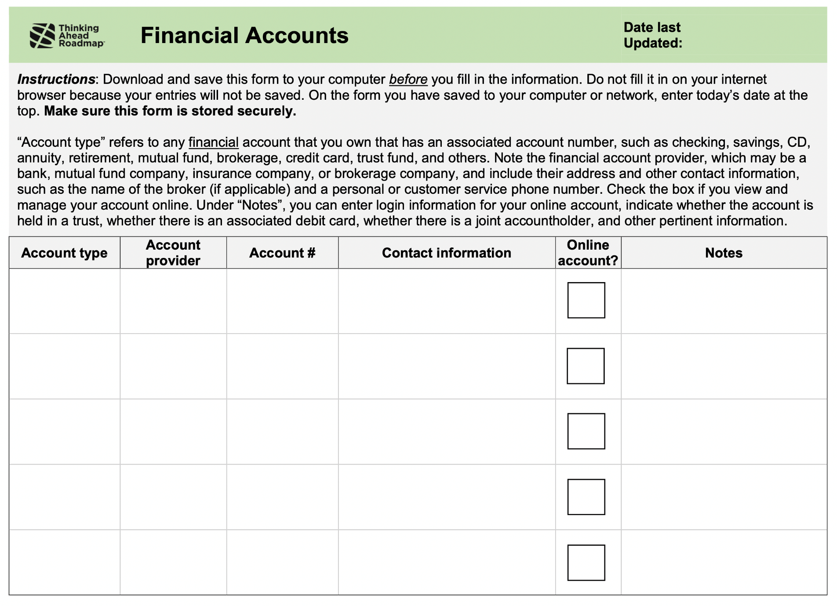

Inventory sample
thinkingaheadroadmap.org/downloads
Notes:
Here is a screen shot of the free, fillable financial inventory that’s on the website of the Thinking Ahead Roadmap. You can download this spreadsheet. There are different tabs that correspond to different aspects of our financial lives, including accounts and regular expenses and bills to pay, and service professionals that we may do business with.

Slide 35

Where should you keep your inventory?
Online
Paper
Notes:
Whatever type of financial inventory or filing system you use, make sure to store it in a safe place!
Either under lock and key or online with a secure password that is only accessible to you and your financial advocates.

Slide 36
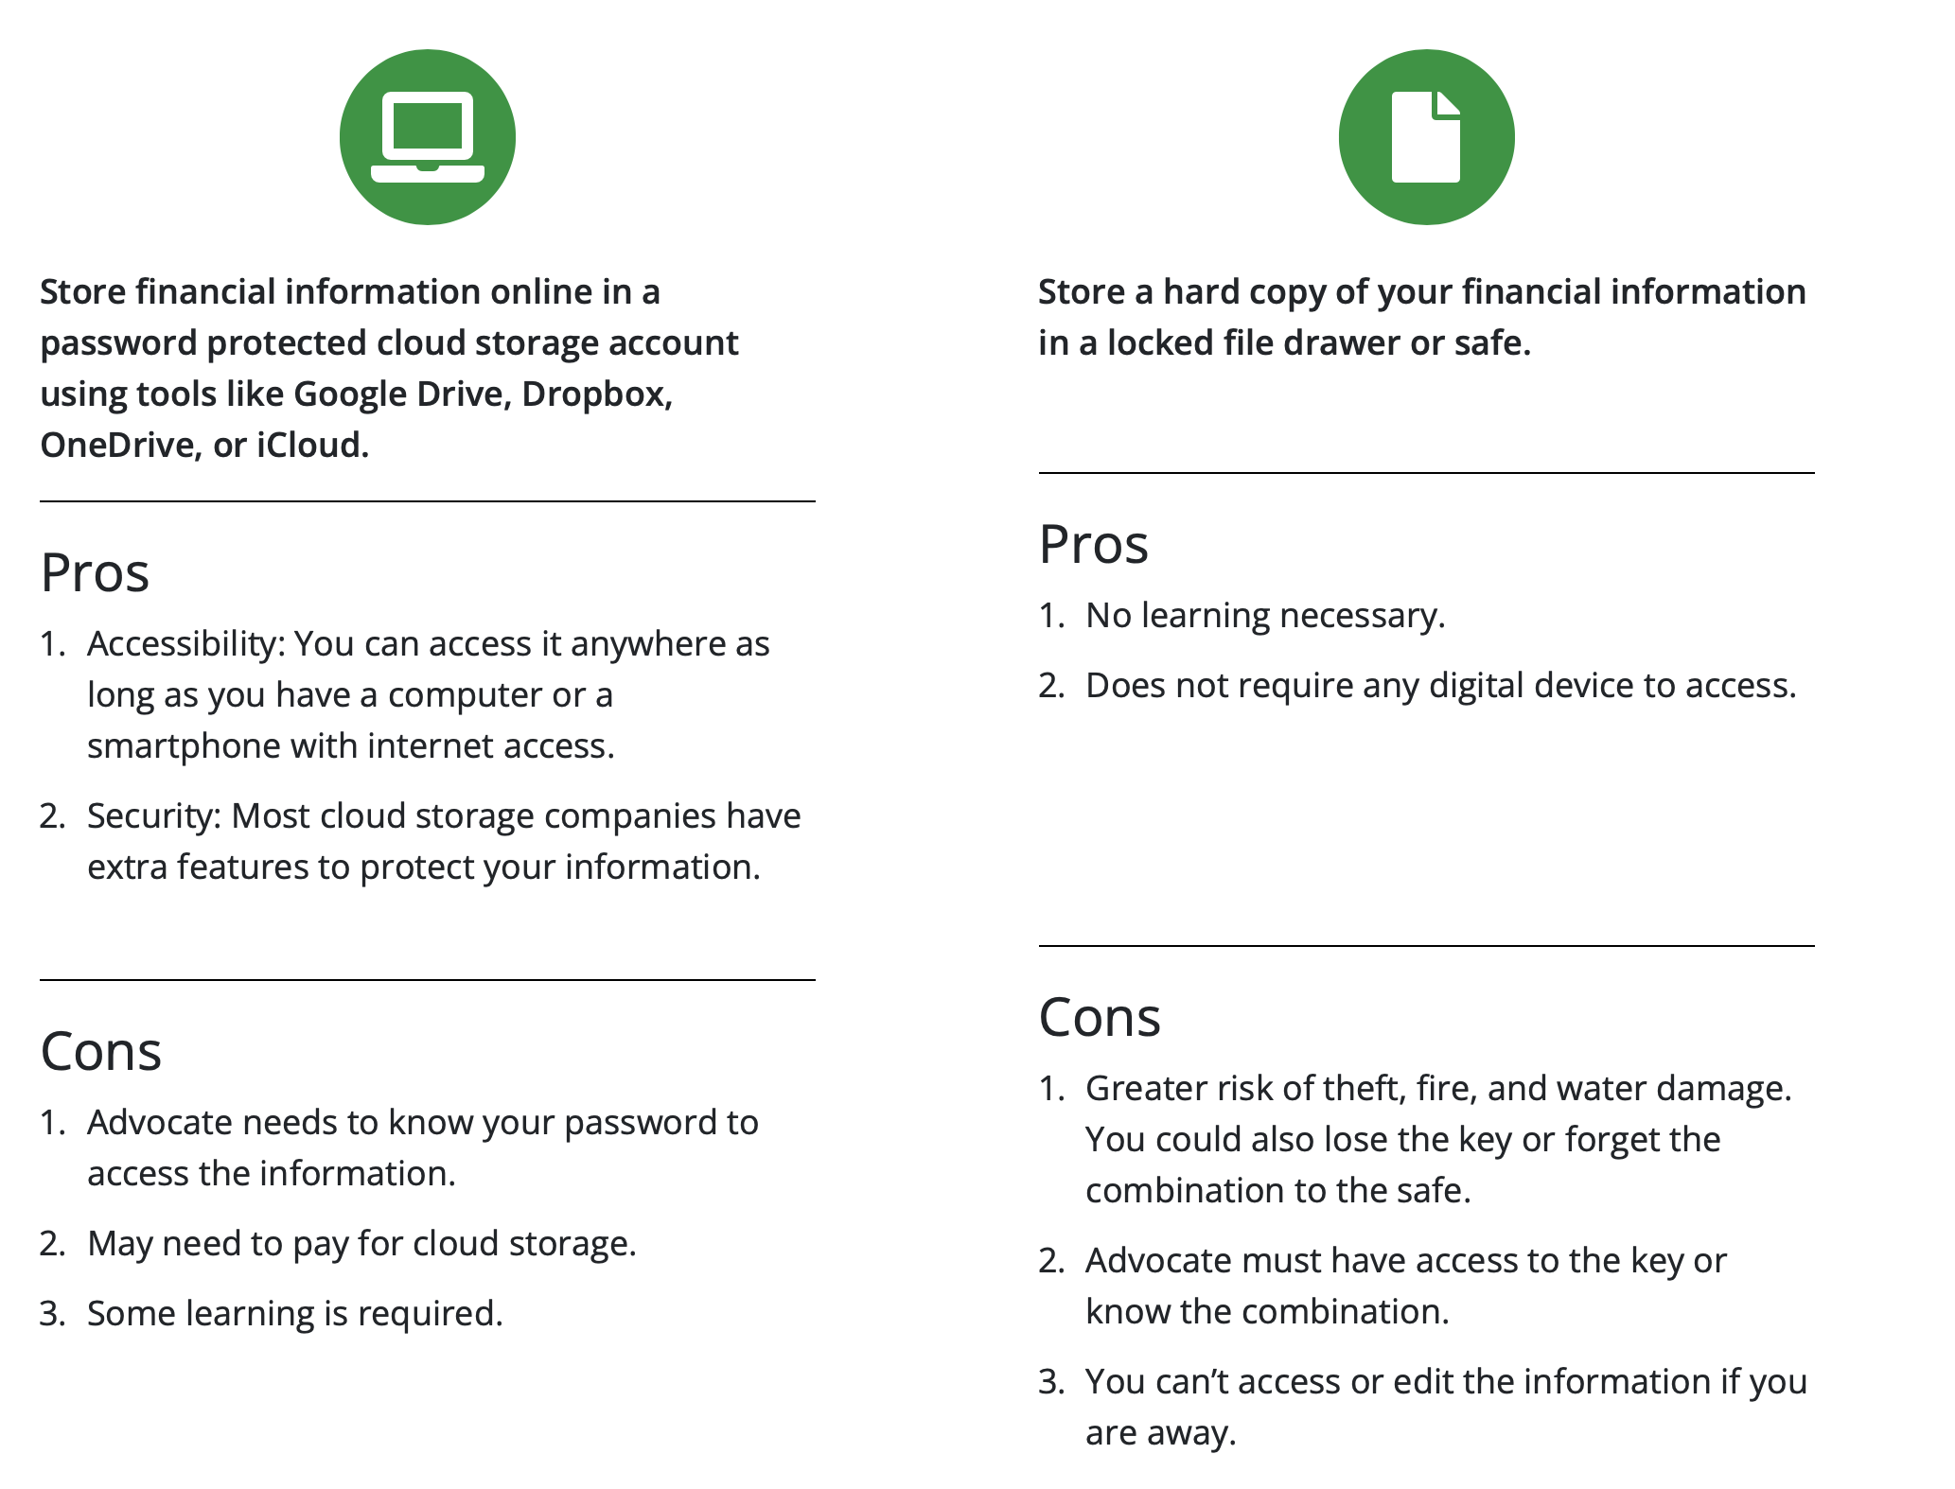
Where should you store your inventory?
Notes:
There are pros and cons for the two methods of storing your financial inventory.
As you can see, there’s not a single answer that works for everybody. You’ll want to consider your preferences and situation when choosing how to store your financial inventory.

Slide 37
Words of wisdom
Use direct deposit for income sources
Use automatic payment for regular bills
Close unnecessary accounts
Apply low limits on credit cards
Set up account alerts to prevent fraud or identity theft
Protect accounts that are managed online
Account lockdowns
Notes:
In addition to creating a financial inventory, here are some additional tips for making it easier for your financial advocate to manage your accounts and keep your money safe.
Simplifying your finances will make things easier for you, too!
[Read bullet points.]
Regarding the second-to-last point, you can protect online accounts by using two-factor log-in, where you input a code that is texted or emailed to you each time you log in to the website. Also, consider using a password manager online that will help you save all of your passwords securely for your reference so you don’t have to remember them or write them down.
Regarding the last bullet point, “account lockdown” can help protect accounts with significant amounts of your long-term investments or savings. Ask your financial institution about this feature.
Can you think of any other tips to protect your accounts?
[Call on participants who raise their hands.]

Slide 38
SECTION 4
Start an Open Conversation

Slide 39

Talking about money and future financial decision making can feel like the hardest step
However, open conversations are critical.
Open conversations help…
…your financial advocate understand and accept their role
…clarify your financial needs and goals
…clear up misunderstandings
…make it more likely that your financial values are reflected and needs are met in the future
Notes:
Next we are going to talk about having open and honest conversations about future money management with the person we want to make our financial advocate.
This can be a challenge, especially for those of us who are more private about our financial affairs. And sometimes the person we are talking to wants to avoid the subject of aging and needing help. But open conversations are critical.
Open conversations help ensure that your financial advocate understands their roles and responsibilities, and they help you clarify your financial needs and goals. Talking gives your advocate a chance to ask you questions so that they can do the job right. Open conversations also make it more likely that your needs are met in the future.

Slide 40

How do you begin?
It’s best to find a time when you’re alone with your financial advocate and no one feels rushed or distracted.
The first conversation is really about getting confirmation from your financial advocate that they are open to help.
Notes:
[Read slide]
You want to hear that your advocate is willing to help you manage your money in the future, should you ever need assistance.

Slide 41
Activity: Worksheet
First, consider what’s important to you…
Completing the financial values quiz and discussing your responses will help you and your advocate better understand your financial values and goals. But remember that your needs and circumstances may change as you age.
Notes:
Before we begin mapping out how to have a conversation and what we will say, I want us each to consider what we value in terms of how our money is used in the future.
I would like each person to do a solo activity by completing the questions on the worksheet. Consider this a “self-assessment” questionnaire. It may be helpful to discuss your answers with your advocate, so that they know what’s important to you.
[Hold up, pass out, or display a copy of worksheet if virtual presentation.]
We’ll take 5 to 6 minutes for this solo activity before moving on.

Slide 42
The four “Ws”
Visualizing and planning the conversation will help you get started.
WHO should be there?
WHEN do you plan to have the conversation?
WHERE should the conversation take place?
WHAT do you plan to say?
Notes:
Visualizing how you will initiate the conversation with the advocate you’ve picked is a great way to motivate yourself to get started. Let’s focus on the 4 Ws.
WHO should be there:
Well, definitely your preferred financial advocate and perhaps your alternate advocate. And maybe you want other family members or close friends to join, too, so that everyone hears the same information. But you can also wait until later to talk with the whole family once you’ve had a conversation with your advocate.
WHEN to talk:
It’s critical to have started these conversations if there has been a major health event or life milestone. But ideally, you will start these conversations happen before any major life even that might affect your independence. Think about the best time, maybe after a meal when you are not rushed or distracted. Sometimes people don’t see their financial advocate very often, maybe they live out of state. So in that case, you should set aside time to have the conversation the next time you are together. Or make a plan to talk on the phone specifically about this topic.
WHERE to talk:
You could bring up these topics after a family meal, during a long drive, or while you’re checking in by phone or video chat. Or it could be when you are on a walk with your advocate or after religious services. Some people even have these conversations at their lawyer or financial advisor’s office, especially if they feel it’s important to have a neutral third party there.
WHAT to say:
Plan what you want to say in advance. Visualize your talking points.

Slide 43
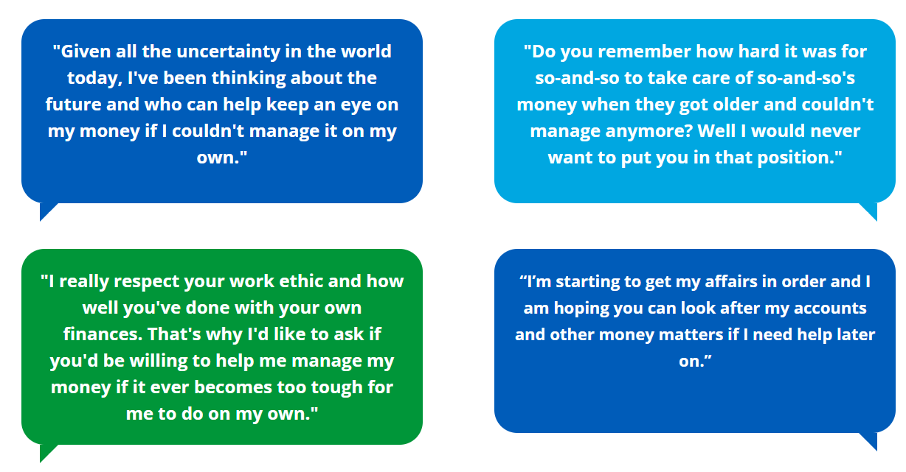
Conversation starters you might try
Notes:
Starting the chat can be hard. Here are some examples of how others have started the conversation.
[Read 1 or 2 conversation bubbles.]
What are some other good conversation starters?
[Ask participants to share ideas and call on those who raise their hands.]

Slide 44
Activity: Worksheet
Complete the four Ws worksheet and document what you hope to accomplish from the conversation
Notes:
Now I would like each person to complete their own Four Ws using the next worksheet.
[Hold up, pass out, or display a copy of worksheet if virtual presentation.]
We’ll take 5 to 6 minutes for this solo activity before moving on. Again, this is something that you will keep. I will not be collecting the worksheets.

Slide 45
Activity: Group response
If they say….
“This is depressing. I don’t want to think about you getting older.”
Notes:
Sometimes we get pushback when trying to start a conversation with the person we select to be our financial advocate. Let’s go over some common reactions and come up with strategies of our own to overcome them. This is a group activity.
If you try to have a conversation with your advocate and they say, “This is depressing. I don’t want to think about you getting older,” how will you respond?
[Call on participants to share their ideas.]
[Reveal example response by clicking to the next slide.]

Slide 46
Activity: Group response
You might say…
“It might be hard to talk about it at first, but having this conversation now will make things easier down the road. It will make me feel better to know that I can count on you.”
Notes:
[Read slide.]

Slide 47
Activity: Group response
If they say….
“Do we have to talk about this now? I have a lot of other things on my mind.”
Notes:
Imagine that this time that your advocate says, “Do we have to talk about this now? I have a lot of other things on my mind.”
What might you say in return?
[Call on participants to share their ideas.]
[Reveal example response by clicking to the next slide.]

Slide 48
Activity: Group response
You might say…
“We can pick up the conversation later when you have less on your mind. But this is important, so let’s put a date and time on the calendar to sit down and talk.”
Notes:
[Read slide.]

Slide 49
What do you hope to accomplish?
In the first conversation, you should get confirmation from your preferred financial advocate that they are willing and up to the task.
You may also want to share:
• Where your financial inventory is stored
• How to access it
• Special requests for how you want your money to be used
Give them a copy of “What you need to know as a financial advocate” available on the website.
thinkingaheadroadmap.org/downloads
Notes:
You don’t need to cover everything in a single conversation. The initial conversation is more about answering their questions and making sure they are willing and up to the task.
Based on how the first conversation is going, you can also share where your financial inventory is stored and how to access it. You can also talk about your financial values.
There is a handout on the Thinking Ahead Roadmap website that you should share with your finanical advocate. It’s called “What you need to know as a financial advocate”

Slide 50
It’s okay not to share everything during the first conversation
You can save details about your accounts, debts, and other legal and financial information for a future discussion.
Later on, you’ll want to walk your advocate through the financial inventory you created.
You may want to communicate to other family members your decision about who will be your primary and alternate financial advocates.
Notes:
If you have several financial advocates that will be in charge of different tasks, such as someone to manage investment accounts and someone else to pay bills, you can meet with your advocates separately or as a team.
Just make sure everyone is comfortable with their role and understands what roles the others have. They will need to keep in touch with each other to coordinate your care.
And maybe you have other people in your life who you don’t want to be involved in your finances but who you think might feel left out. This is common in many families. One way to address this is to assign those people other important future roles, such as taking you shopping or to the doctor, or to manage housework and yardwork.

Slide 51
Activity: Role play
Step 1: Select a conversation partner sitting near you.
Step 2: Take turns role playing the start of a conversation between you and your financial advocate:
Set the scene—Where is the imaginary conversation taking place? Who is present? What are you going to say? How might others react?
Step 3: With the group, describe how it felt to role play the conversation. What came up for you and for your conversation partner? What did you learn?
Notes:
Practice makes perfect. Let’s do a role-playing exercise where we act out having a conversation with our primary or alternate financial advocate, whichever person feels harder to talk to. Your conversation partner will act as your financial advocate and will react naturally to what you have to say.
First, set the scene. Tell your partner where the conversation is taking place, who is present, and then practice what you will say. After a few minutes, we’ll switch and the other person will take a turn as the conversation leader.
Let’s aim for about 4 minutes each this time. I will let you know when it is time to switch.
After the 8 minutes are up, I will call us back as a group and ask just a few people to share how it went and what they learned from the role-play.

Slide 52

SECTION 5
Make it Official
Notes:
Now we’re up to Step 5 of the Roadmap: Making it Official

Slide 53
Why do I need to give my advocate legal authority?
To get important tasks done: pay bills, make withdrawals, manage money and property
So that banks, brokers, retirement plans, and others will recognize that your advocate can act for you
So that no one will have to go to court and get a guardian appointed for you, which is expensive, public, and you don’t get to pick your person
Notes:
So, you’ve decided who to name as your advocate, had some conversations, organized your finances, and made sure your financial advocate knows how you want your finances managed if you can’t do it yourself. Are you done?
No, not yet!
A critical step is to give your financial advocate the legal authority to step into your shoes and act on your behalf. Generally you will do this by naming them in a power of attorney document, although there are exceptions.
Why do you need to take this legal step? Why can’t it just be an informal arrangement? There are a few key reasons:
--Without legal authority, your advocate won’t be empowered to do all of the things you’ll need, such as paying bills, withdrawing money from accounts, managing any property you may own, and generally making financial decisions.
--Financial services providers—such as banks, brokers, retirement fund managers and even government agencies-- will want to make sure that your advocate has the legal power to act for you. For example, without legal documentation they might not let your advocate get account information or withdraw money.
--If you don’t give your advocate authority in advance and something happens, a family member, friend or someone else may have to go to court to get a guardian appointed. This is a public court proceeding, it can be expensive, it takes time, and you don’t get to pick the person who can manage your money and property.
Making it official is one more way to ensure that YOU stay in control.

Slide 54
What’s a financial power of attorney (POA)?
A POA is a legal document that gives someone else the legal right to make decisions about your money and property.
You are called the “principal” and your financial advocate is called your “agent”.
You can name an alternate to take over if the primary agent becomes unavailable.
Notes:
Here are the basic concepts you need to know about financial powers of attorney.
[Read bullet points]

Slide 55
Activity: TRUE OR FALSE
TRUE OR FALSE????
You don’t need a power of attorney (POA) if you have a will.
Notes:
Now let’s play “TRUE OR FALSE???”
You don’t need a power of attorney (POA) if you have a will.
[Ask participants if this is true or false. You can use a show of hands. Click to the next slide to reveal the answer.]

Slide 56
Activity: TRUE OR FALSE
You don’t need a power of attorney (POA) if you have a will.
ANSWER: FALSE!
A power of attorney allows someone to manage your money while you are alive, while a will specifies how you want to pass along your money and property after you die.
thinkingaheadroadmap.org/downloads
Notes:
False – a power of attorney allows someone to manage your money while you are alive, while a will specifies how you want to pass along your money and property after you die.
For most people, it’s important to have both a power of attorney AND a will.
A power of attorney is also different than a LIVING TRUST. A lawyer might recommend a living trust if you have property in more than one state, have complex business holdings, or have a large amount of money you want professionally managed.
The Thinking Ahead Roadmap website includes a sample POA form. This isn’t a form meant for you to use—it’s to give you an idea of what a POA might look like and include.

Slide 57
Activity: TRUE OR FALSE
TRUE OR FALSE????
If you add your advocate to your accounts, you don’t need a POA.
Notes:
True or false? If you add your advocate to your accounts, you don’t need a POA.
[Ask participants if this is true or false. You can use a show of hands. Click to the next slide to reveal the answer.]

Slide 58
Activity: TRUE OR FALSE
You don’t need a power of attorney (POA) if you just add your advocate to your accounts.
ANSWER: FALSE!
Joint accounts can be right for some situations but they don’t take the place of a POA or other legal arrangements. You will likely have other money and property that needs to be managed. And joint accounts have some risks.
Notes:
The correct answer is FALSE. Your advocate needs broad legal authority to manage all aspects of your finances, not just a particular bank or other account. Joint accounts can be right for sharing resources with a spouse or partner. But your advocate needs to be able to do things like managing your home and other real estate, signing agreements, managing your debts, applying for benefits, and filing your taxes.
There are some aspects of joint accounts that can cause problems and you need to know about them:
--The second person on the account usually has equal access and claim to the money. They can withdraw it and spend it on themselves.
--If the second person on the account has debts, their creditors may be able to get your money that’s in the account.
--When you die, the second person gets the money in the account. That might mess up your plans. For example, you might want all of your children to inherit equally, but only one child will get the money in the joint account.

Slide 59
Activity: TRUE OR FALSE
TRUE OR FALSE????
You can change or revoke your POA at any time.
Notes:
True or False? You can change or revoke your POA at any time.
[Ask participants if this is true or false. You can use a show of hands. Click to the next slide to reveal the answer.]

Slide 60
Activity: TRUE OR FALSE
You can change or revoke your POA at any time.
ANSWER: (MOSTLY) TRUE!
As long as you still can understand what it means to change or “revoke” the POA, you can change what’s in the document or cancel it anytime.
Notes:
This statement is generally TRUE. As long as you understand the actions you are taking and the results, you can change what’s in your POA or cancel it at any time. The legal term for cancelling a POA is to revoke it. Perhaps you no longer trust the person you named as your agent, or your agent gets sick or dies. You can revoke the POA and make a new one naming someone else to be your agent. You also could change the powers you are giving to your agent.
If you are experiencing mid or later stage dementia or had a stroke that impaired your reasoning abilities, it’s possible that you will not have the capacity to revoke or change your POA. That rule is designed to protect you from untrustworthy people attempting to take control of your finances when you are not in a position to protect yourself and safeguard your money from bad actors.

Slide 61
Activity: TRUE OR FALSE
TRUE OR FALSE????
You can download a standard POA from the Internet and don’t need to see a lawyer.
Notes:
True or False? You can download a standard POA from the Internet and don’t need to see a lawyer.
[Ask participants if this is true or false. You can use a show of hands. Click to the next slide to reveal the answer.]

Slide 62
Activity: TRUE OR FALSE
You can just download a standard POA from the Internet and don’t need to see a lawyer.
ANSWER: Sort of TRUE, sort of FALSE!
The most important things are to have a POA document that meets your state laws and does what you need it to do. Be cautious about “one size fits all” forms. Hiring a lawyer does not need to be complicated or expensive.
Notes:
The correct answer is “it’s complicated”.
It is very important to have a POA document that meets your particular needs and that meets the requirements of your state’s laws. Hiring a lawyer will ensure that you have personalized service, someone to answer your questions, and that your state’s legal requirements are met. Depending on your situation, there may be free or low-cost options for legal services. The Thinking Ahead Roadmap makes suggestions on how to find affordable legal help.
There are also online services and forms that can help you get a POA for free or at low cost. These could work in simple situations. But even if your situation seems simple, there may be issues you haven’t thought about. Also, even if it isn’t required, it may be a good idea to have your POA notarized because banks and other third parties may be more willing to accept the POA.

Slide 63
Activity: TRUE OR FALSE
TRUE OR FALSE????
Your POA must meet your state’s legal requirements.
Notes:
Last one: Your POA must meet your state’s legal requirements, TRUE OR FALSE?
[Ask participants if this is true or false. You can use a show of hands. Click to the next slide to reveal the answer.]

Slide 64
Activity: TRUE OR FALSE
Your POA must meet your state’s laws.
ANSWER: TRUE!
Your state’s requirement might say that you need the document witnessed or notarized, or signed by your agent. Your state’s laws might specify what powers you can give your agent and whether you must use special wording.
Notes:
This is TRUE! We mentioned that in relation to the last question but want to emphasize this point. Your state’s law might relate to procedures such as whether you need the document witnessed or notarized or signed by your agent. But your state laws also might relate to what the document says, such as what powers you can give your agent and whether you must use special wording.

Slide 65
Words of wisdom
A POA should be “durable,” meaning your advocate can act for you even when you can no longer make decisions on your own.
Your advocate only gets the powers you give them—and you can specify whether the POA goes into effect now or later.
Your advocate has a legal duty under the POA to act in YOUR best interests. This is called “fiduciary duty.”
Notes:
Make sure that your POA is “durable.” This means that your advocate can act for you even when you can no longer make decisions on your own. That’s the point of using a POA to make future plans. It assures that your advocate can take care of your financial matters up until your death.
Although you are mostly concerned about having a financial advocate who can act on your behalf later, many people make their powers of attorney effective immediately. Even if you make your POA effective immediately, your advocate doesn’t need to start managing your money right away. You can still be in full control, but your agent will be able to step in as soon as they are needed.
However, you do have the option of making your POA effective later, at the point when you no longer can manage your finances. This approach may require extra steps that may be hard on you and your agent.
Remember that your advocate only gets the powers you give them. Your POA document spells out what your advocate can do.
Your advocate MUST act in your best interests. Using legal terms, acting in your best interest is a FIDUCIARY DUTY—an obligation under the law.

Slide 66
Trust, but verify!
Build in ways for other trusted people to see how your advocate is managing your money and property.
Options to put in your POA:
Require your advocate to “open the books” to another trusted person.
Require a second signature for large transactions.
These are ways to include others in your family or social circle.
Notes:
You have chosen a financial advocate who you believe is trustworthy and able to manage your money according to what you would want. But it’s always good to have another set of eyes on how your advocate is handling your finances. Your POA document can include requirements for sharing information with other trusted family members or people in your social circle. You can require your advocate to “open the books” every so often, such as every six months or once a year. You can also require a second person to sign off on large transactions.
If you choose to “trust, but verify,”, explain these requirements in advance to your financial advocate. You might tell them that these are ways to include others in your circle, and can help them be organized and keep good records of your finances. Reassure them that you trust them—otherwise you wouldn’t have chosen them in the first place!

Slide 67
How can I get a POA? Here are some options:
Hire a lawyer -- call a few to see what they charge and what their specialties are
Get free legal services if you are eligible
Employers may provide low-cost legal services
Online services may be free or low-cost—but beware of “one-size-fits-all” forms
Notes:
Getting a POA may seem daunting. It shouldn’t be. Here are some options.
--Hiring a lawyer ensures that you get personalized service, that your needs and wishes are met, and that the document meets state requirements. The cost is probably more manageable than you think. And it’s good investment in your financial future. Call a few lawyers to find out what they charge. Lawyers who specialize in POAs are called estate planning attorneys or elder law attorneys—but many lawyers with general practices can create POAs too.
--There are many legal services programs that provide free assistance. Find out whether you qualify and what services they offer.
--Some employers provide access to low-cost lawyers as an employee benefit. Check with your human resources department or employee assistance plan.
--You can get a POA online. These POA forms may work in simple situations. But be careful of downloading a “one-size-fits-all” form from the Internet. There may be issues particular to your situation, and you want to be sure your POA follows state law.
--It’s a good idea to get a POA notarized, even if your state doesn’t require it.

Slide 68
Resources for Getting a Power of Attorney
Free legal services for people over age 60
Find local programs that provide free legal help to people over age 60 by contacting the national Eldercare Locator.
1-800-677-1116
www.eldercare.acl.gov/
Free legal services for those with modest income
Find local programs that provide free legal help to income eligible people on the website of the Legal Services Corporation. www.lsc.gov/find-legal-aid
Fee-for-service lawyers
This is a web page sponsored by the American Bar Association. It provides information about how to find a lawyer in each state. It also has information about legal resources available in each state, how to check whether a lawyer is licensed, and what to do if you have problems with a lawyer. www.findlegalhelp.org
Notes:
Here are some websites and phone numbers to help you find legal help. This information is available through the Thinking Ahead Roadmap website.

Slide 69
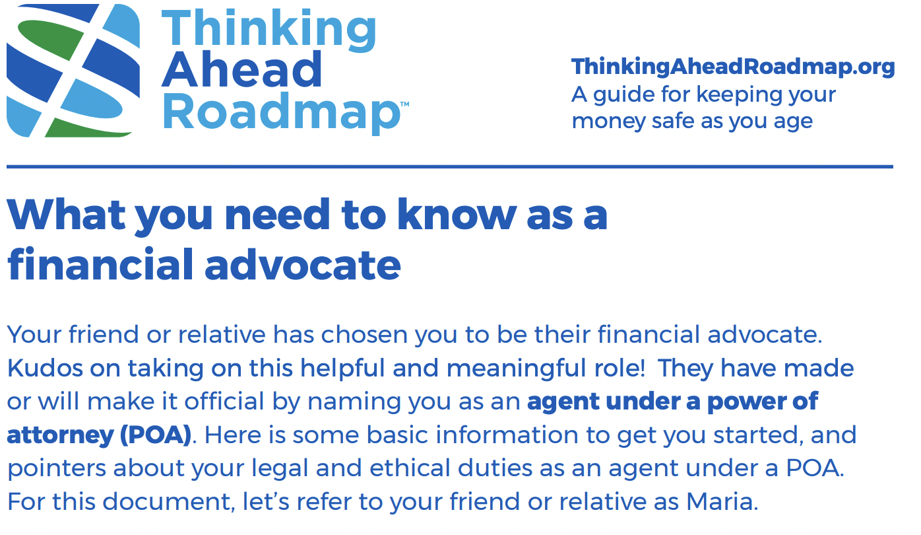
Help your advocate help you!
This handout explains your financial advocate’s duties under a POA. Give them a copy to make their job easier!
thinkingaheadroadmap.org/downloads
Notes:
To help your advocate understand their duties, check out the Thinking Ahead Roadmap handout called “What you need to know as a financial advocate.” It’s a great idea to give your advocate a copy. This is available from the website using the link on the slide.

Slide 70
SECTION 6
Planning a Smooth Transition
Notes:
Now let’s discuss how to hand off responsibilities for managing your finances to your financial advocate. We’ll also talk about the right time for the hand-off.

Slide 71
Advantages of a gradual transition
You have a longer runway to plan and share important information
It is less stressful for all people involved
There are fewer chances for financial losses to occur
You can give your advocate time for a “test drive” and see how they manage a financial task or two
Notes:
Here are the advantages of a gradual transition.
[Read slide.]
Of course, there could be situations where gradual transition isn’t possible, and your financial advocate would need to take over immediately. We’ll discuss these situations in a few minutes.

Slide 72
What could a gradual transition look like?
Begin planning steps before there is a need for help
Simplify your finances
Agree on an “early warning system” ahead of time
Share your financial inventory with your advocate(s)
Hold an annual meeting to review finances and any changes
Begin sharing tasks
Notes:
Here’s what a gradual transition could look like. Note that it involves thinking ahead to that time when you might need help.
[Read numbered sections.]
Thinking about point number 6: One possibility is to hand off a few tasks that create a lot of stress for you, to get your financial advocate started. You could keep tasks that you can still handle easily. The idea is to start slow, and then ramp up later when you might need more help from your advocate.

Slide 73

How will you know it’s time to transition financial responsibilities?
Plan an early warning system
Notes:
The Thinking Ahead Roadmap distinguishes between blazing red emergency signals and yellow caution lights that indicate when it is time to get your financial advocate involved in your financial decision making.
Emergency signals indicate it may be time to transfer responsibilities NOW.
Caution lights mean it may be time to start a gradual transition, if you haven’t started already, and to be on alert if more signals emerge. The Thinking Ahead Roadmap gives you examples of these signals that it’s time for your advocate to help.
It’s common to be unaware that you are experiencing these signals. Or, you might be susceptible to “wishful thinking” that everything is ok.
Another possibility is that you don’t want to worry your adult children or other relatives.
To guard against these situations, you might want to develop your own “early warning signals” that could apply to your circumstances. Then you could ask close family and friends to tell you if they see you experiencing these signals. If you commit in advance to receiving help when these signals happen, you might not resist as much when it’s time to get help.

Slide 74

Activity: Group response
What are some signs that an urgent transition is needed?
Diagnosis of dementia or serious medical condition
Doctor, lawyer, accountant expresses concern
Death of a spouse/partner, survivor unable to take over
Serious financial or safety mistakes
Significant financial losses from fraud or scams
Easily lost when walking or driving
Credit card charges you don’t remember
New “friends” appear and obtain account access
Notes:
What signs do you consider to be emergency signals that it’s time to get assistance with money management right away?
[Ask participants to call out emergency signals.]
Here are the signs that it might be time to get help immediately.
[Click to reveal signals.]
Serious mistakes could be forgetting to file taxes, forgetting to pay bills or insurance premiums, or forgetting to take medications.
In some cases, one spouse handles all the finances, and if that person dies or becomes seriously ill, the other spouse may not be ready to handle the finances. Another possibility would be that the surviving spouse is frail or grieving, so that could be a good time to get help.

Slide 75

Activity: Group response
What are early caution signs that suggests it’s time to start a gradual transition?
Needing caregivers
Don’t feel safe driving
Spending more time alone
Neglecting common tasks
Forgetting to pay a few bills
Not returning phone calls or emails
Neglecting hobbies or interests
Trouble doing business on computer or phone
Notes:
What are some less severe signs that it might be time to start a gradual transition?
[Ask participants to call out warning light signals.]
Here are some signals that it might be time transfer some responsibilities.
[Click to reveal signals.]
Regarding the first signal, often older adults hire paid caregivers to help them with their activities of daily living. However, you should not leave financial papers, checkbooks, passwords to online accounts, or other account information where caregivers can access them. It’s never a good idea to involve paid caregivers in your finances -- leave that to job to financial advocates.
Could some of these signals also be considered emergency signals? It can be a gray area between the two types of signals.

Slide 76
Activity: Pair & Share
Step 1: Select a conversation partner sitting near you.
Step 2: Take turns responding to the following prompt (3 min each):
PROMPT: Did you have older relatives or friends who needed help? What were the signs? Who noticed the signs? Did the older person resist or deny that the signs were present?
Step 3: Volunteers share what they discussed with their partner with the facilitator and broader group
Notes:
You can learn a lot about the experiences of older relatives or friends who needed help. Here’s our final pair and share exercise to stimulate your thinking.
Did you have older relatives or friends who needed help? What were the signs? Who noticed the signs? Did the older person resist or deny that the signs were present?
Let’s aim for about 3 minutes each. I will let you know when to switch.
After the 6 minutes are up, I will call us back as a group and ask just a few people to share how it went and what they discussed.

Slide 77

Activity: Worksheet
What is your transition plan?
Who should be in your convoy of support?
What could be your early warning signals?
Which money or property management tasks might be transitioned first?
Notes:
Now I’d like you to develop your own transition plan. You’ll have more peace of mind if you have a plan to face whatever happens down the road.
[Hold up, pass out, or display a copy of worksheet if virtual presentation.]
We’ll take 8 minutes for this solo activity before moving on to the wrap up.
You might want to share your plan with your financial advocate and close family or friends, so they know what they might expect. They will feel better if they see you’re planning ahead to make sure things will turn out ok in your later years.

Slide 78
SECTION 7
Wrap up

Slide 79
Where we’ve been/where we’re going
You’ve learned…
Why it’s so important to plan for your financial future and to select a financial advocate
The six steps in the advance financial planning journey
What’s next?
It’s important to start now
We’re all in the same boat (or car) – we can support one another
Notes:
We covered the important steps in the advance financial care planning process, including picking a trustworthy financial advocate, initiating an open conversation, and appointing your advocate as an agent under power of attorney. We hope this workshop gave you a runway to take off and solidify your financial care plan.

Slide 80
Activity: Group review
Before you started this training, how did you feel about advance financial care planning? Did it seem scary or burdensome or confusing?
Do you feel differently about it now? In what way?
When you look back over these sessions, what is one key thing you remember?
What, if anything, still seems challenging?
Do you have any remaining questions?
Notes:
Let’s close with a short group reflection exercise.
[Read questions one-by-one.]
[Participants raise their hand to share their responses.]

Slide 81
Reminders
There is more helpful content available on the Thinking Ahead Roadmap website: thinkingaheadroadmap.org
  Everything on the website is downloadable and printable
Share the handouts with your advocate and others
Revisit your advance financial care plan—and your selection of your advocate—whenever you have major life changes, or periodically even without big changes
Notes:
A final note before we part.
All the details of what you’ve learned in this workshop are available on the website, including the handouts, worksheets, slide and full Thinking Ahead Roadmap booklet.
Remember to revisit your plan every year or whenever you have a major life event.

Slide 82
Happy planning!
Thank you for participating
Notes:
Good luck!

